Slide 1
Fund Performance
Quantitative Analysis for Non-Quants
24 August 2011

Slide 2
Agenda / Contents
01 Return
02 “Risk”
03 Measuring Performance
04 Complementary Risk Measures

Slide 3
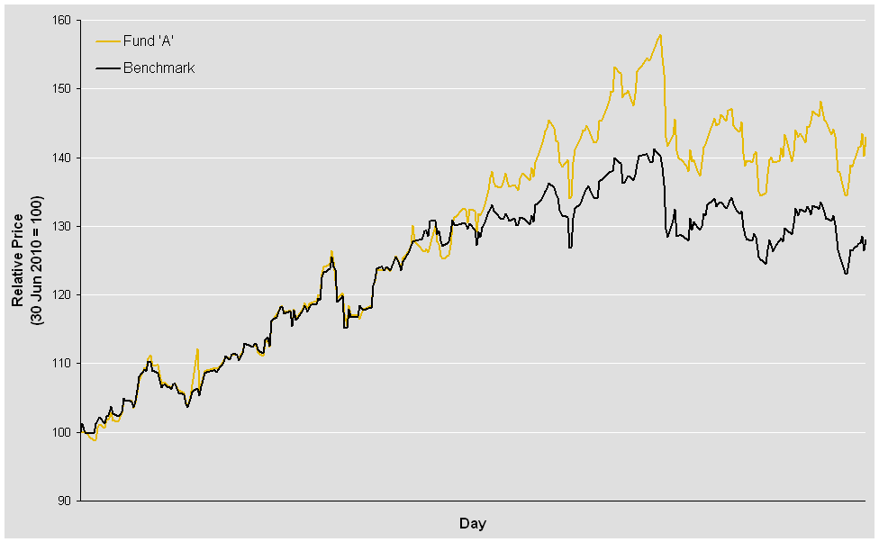
Example Fund
30 Jun 2010 – 19 Aug 2011

Slide 4

Which Return?
…this fund’s targeting an absolute return…
…but our fund has an
active return …
…and this fund talks about a
total return …
…what’s my return ?
…a return smörgåsbord

Slide 5

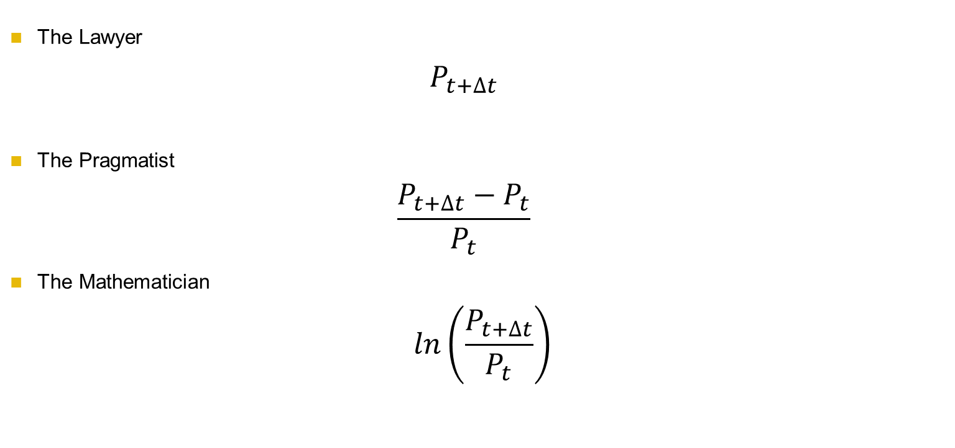
Measuring Return
The Lawyer
  $$P_{t+∆t}$$
The Pragmatist
  $$\frac{P_{t+∆t}−P_{t}}{P_{t}}$$
The Mathematician
  $$ln\left(\frac{P_{t+∆t}}{P_{t}}\right)$$
…what about $∆t$?

Slide 6
Different Measures of $∆t$
$(P_{t+∆t}$)
Used in
Empirical Studies
1 day
1 week
1 month
Often quoted
in the Press
1 year
2 year
3 year
5 year
…why bother?

Slide 7
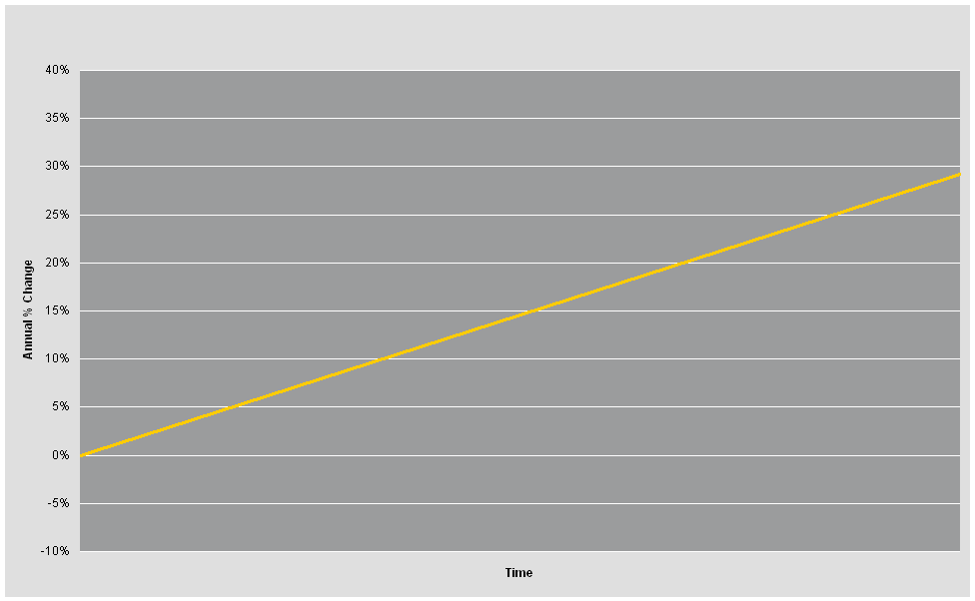
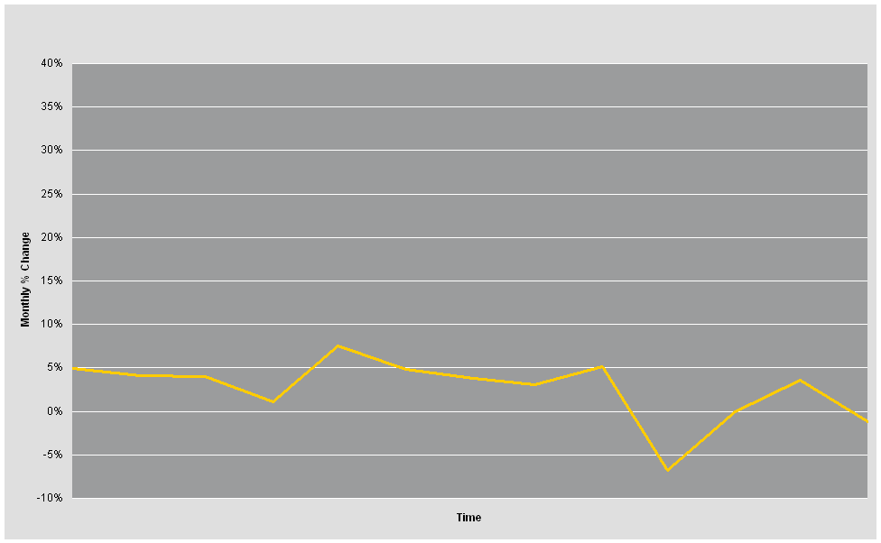
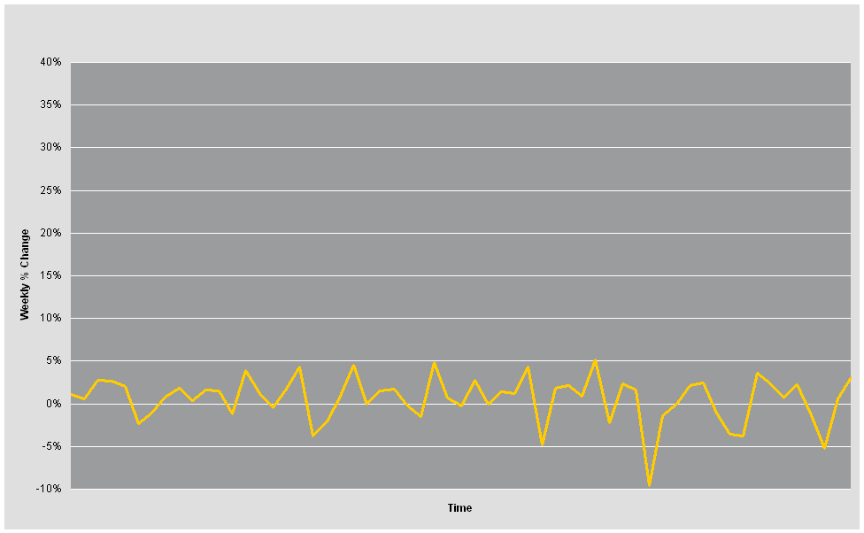
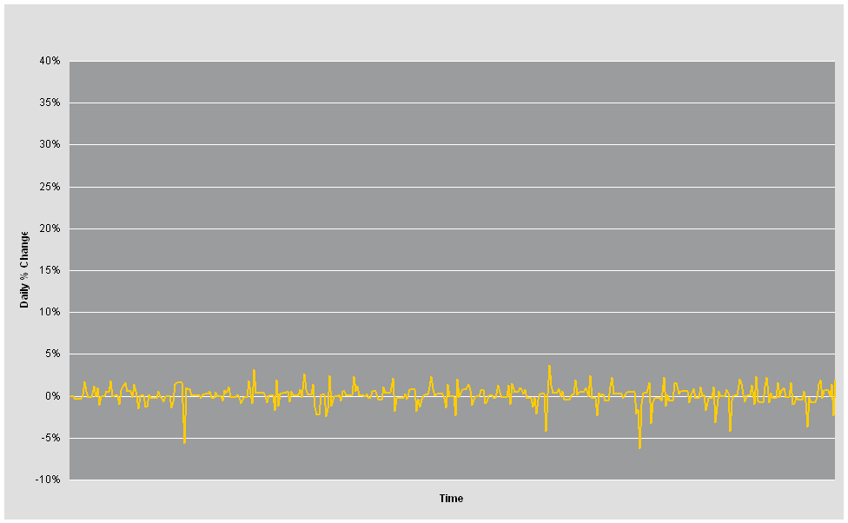
Calculating Return Using Different Measures of $∆t$
  Annual Monthly Weekly Daily
…so what do 1, 2, 3 and 5 year returns tell us?

Slide 8
Focus on Return = Tunnel Vision?
Returns tell you where you got to, but say very little about how you got there
Even average returns quoted for long ‘holding’ period (eg. “average annual return over 5 years”) do not give a complete picture
We need information about the dispersion (ie. variability) of % price changes about the (average) % price change (ie. average return)
…”risk” and its measurement

Slide 9
Example Fund – Daily Price History
30 Jun 2010 – 19 Aug 2011

Slide 10
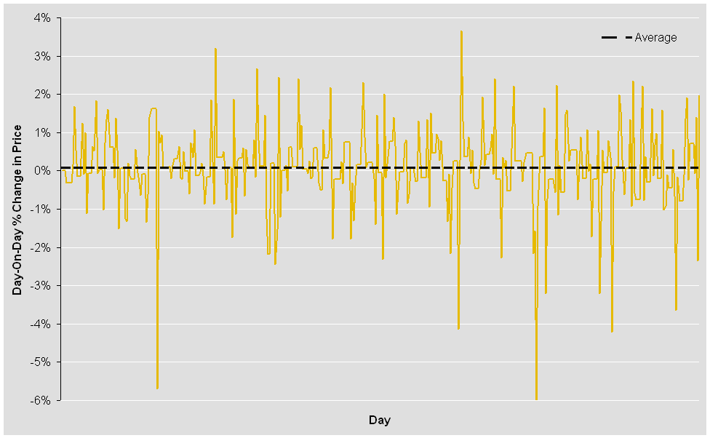
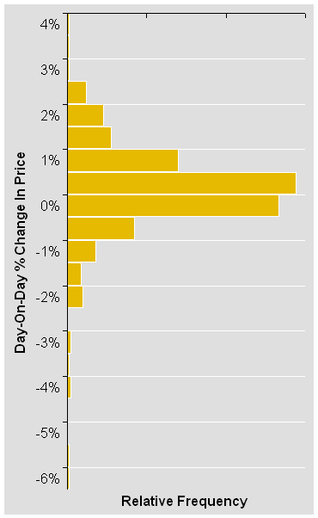
Example Fund – Daily Price Changes
30 Jun 2010 – 19 Aug 2011

Slide 11
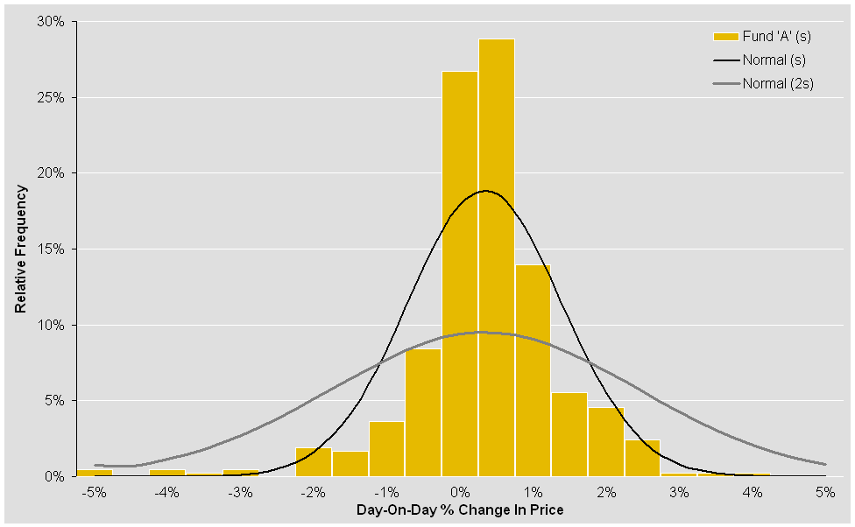
Example Fund – Normality?
…analysing Return and Risk…

Slide 12
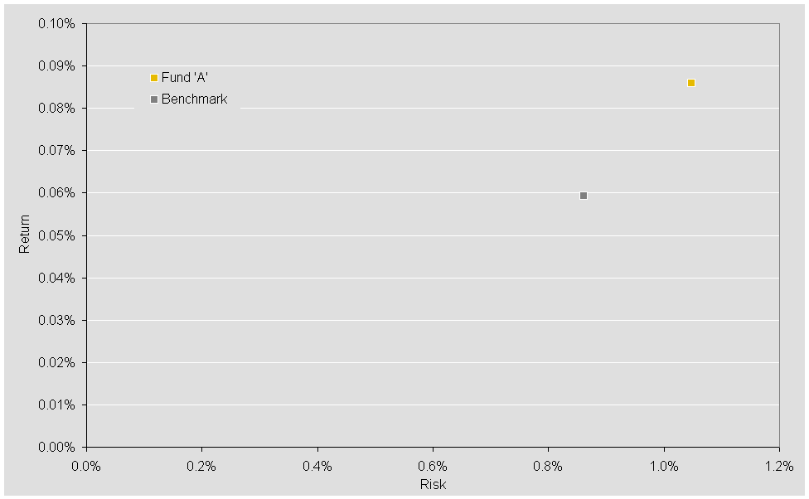
Risk and Return
…compare other funds and BMs

Slide 13
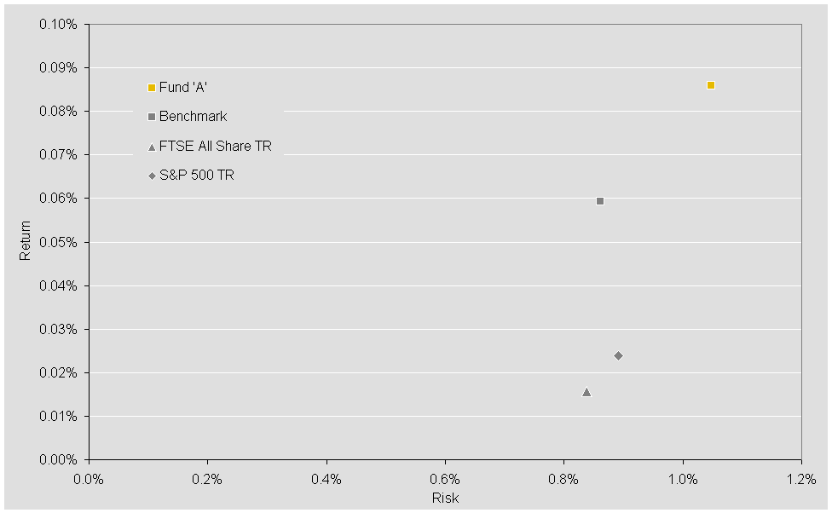
Risk and Return
…Active Return analysis

Slide 14
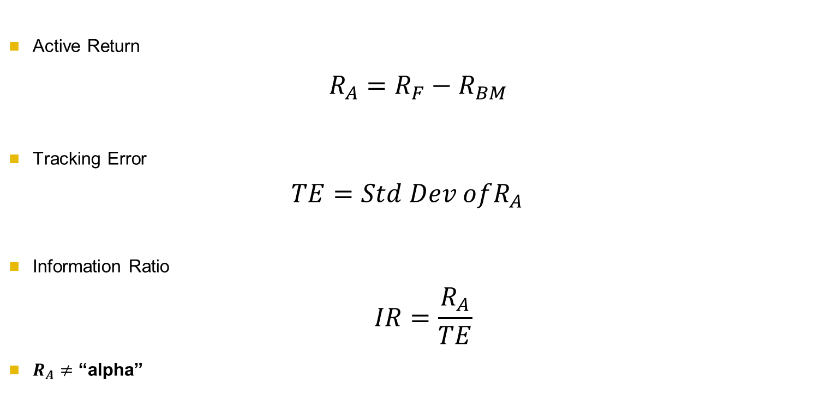
Relative Performance Measurement
Active Return
  $R_{A}=R_{F}−R_{BM}$
Tracking Error
  $$TE=Std Dev ofR_{A}$$
Information Ratio
  $$IR=\frac{R_{A}}{TE}$$
$R_{A}≠$ “alpha”
…finding “alpha”

Slide 15

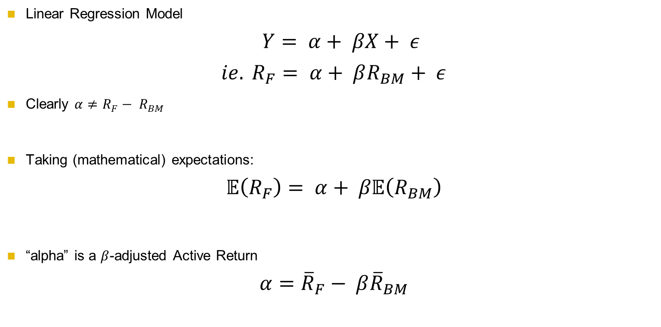
Alpha
Linear Regression Model
$$Y= α+ βX+ ε$$
$$ie. R_{F}= α+ βR_{BM}+ ε$$
Clearly $α≠R_{F}− R_{BM}$
Taking (mathematical) expectations:
$$𝔼\left(R_{F}\right)= α+ β𝔼\left(R_{BM}\right)$$
“alpha” is a $β$-adjusted Active Return
$$α={\overline{R}}_{F}− β{\overline{R}}_{BM}$$
…what is $β$?

Slide 16

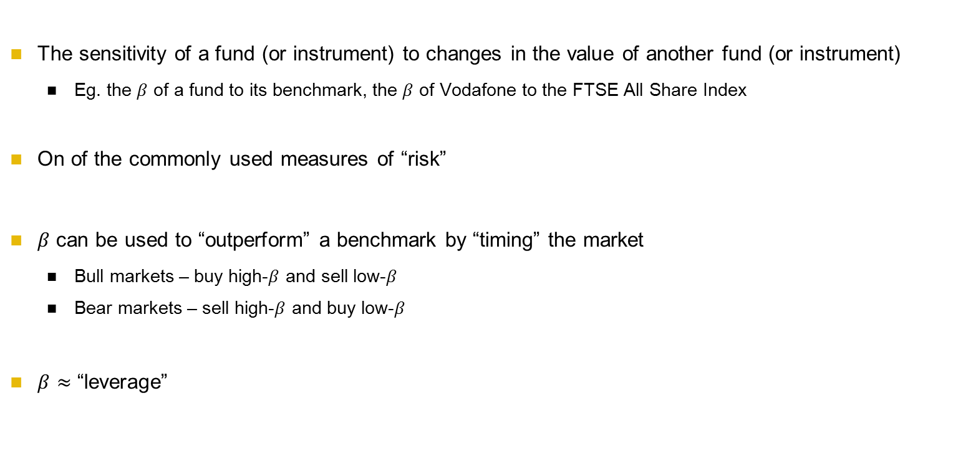
Beta
The sensitivity of a fund (or instrument) to changes in the value of another fund (or instrument)
  Eg. the $β$ of a fund to its benchmark, the $β$ of Vodafone to the FTSE All Share Index
On of the commonly used measures of “risk”
$β$ can be used to “outperform” a benchmark by “timing” the market
  Bull markets – buy high-$β$ and sell low-$β$
  Bear markets – sell high-$β$ and buy low-$β$
  $β≈$ “leverage”
…estimating $α$ and $β$?

Slide 17
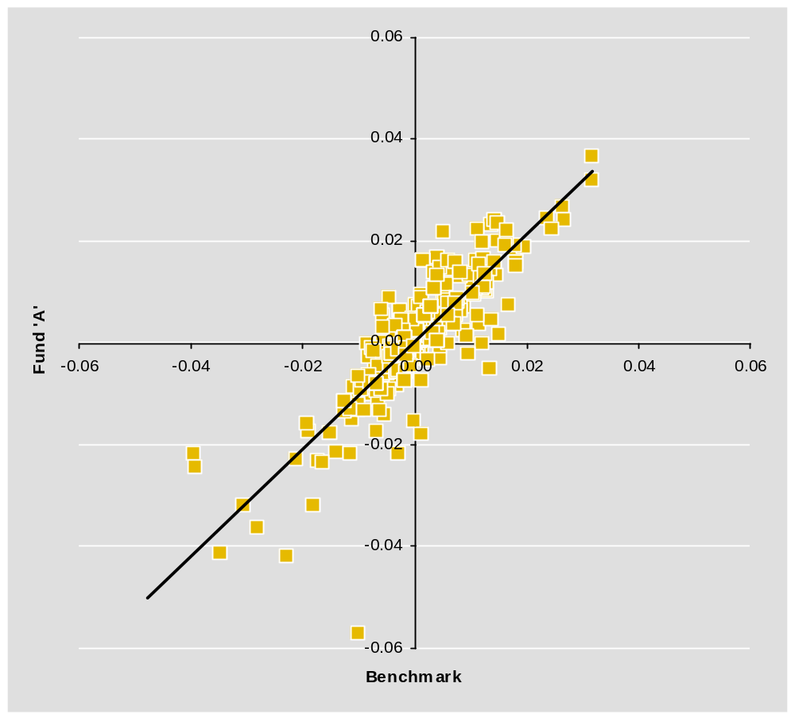

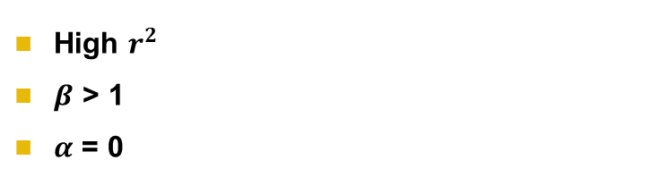
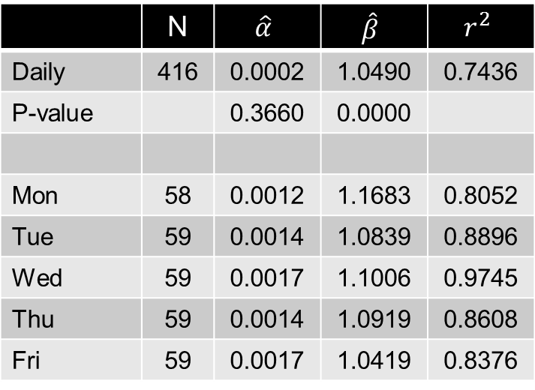
Estimating $α$ and $β$
 | N | $$\hat{α}$$ | $$\hat{β}$$ | $$r^{2}$$
Daily | 416 | 0.0002 | 1.0490 | 0.7436
P-value |  | 0.3660 | 0.0000
Mon | 58 | 0.0012 | 1.1683 | 0.8052
Tue | 59 | 0.0014 | 1.0839 | 0.8896
Wed | 59 | 0.0017 | 1.1006 | 0.9745
Thu | 59 | 0.0014 | 1.0919 | 0.8608
Fri | 59 | 0.0017 | 1.0419 | 0.8376
High $r^{2}$
$β$ > 1
$α$ = 0
…$α$ as misspecified $β$?

Slide 18
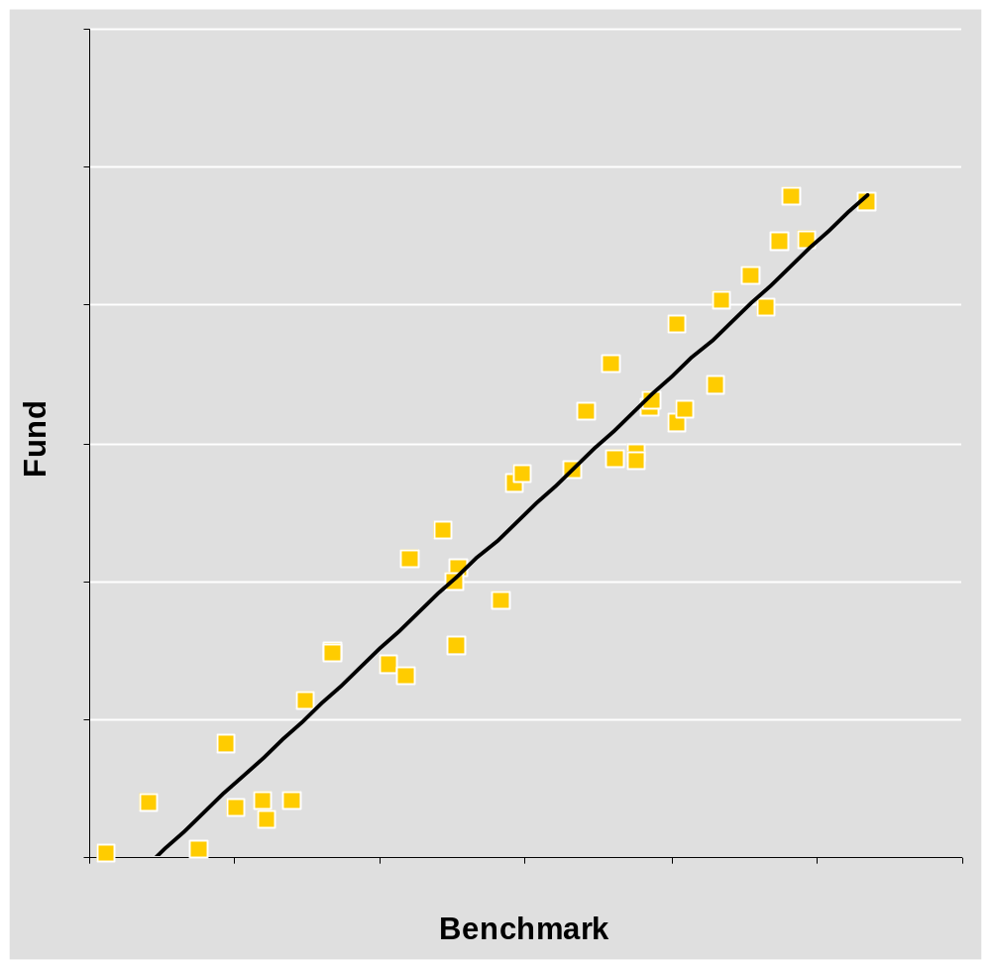

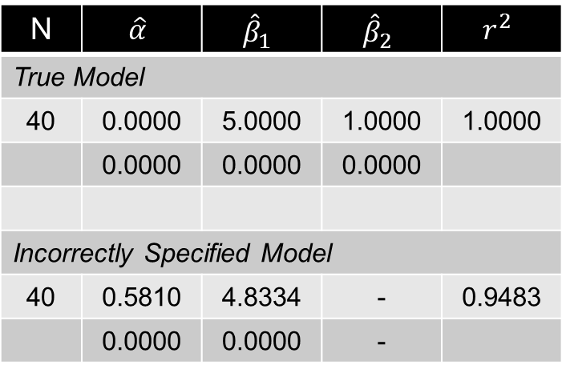
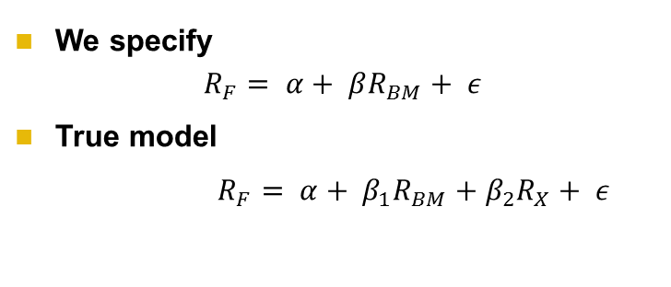
Incorrectly Specifying the Regression
We specify
$$R_{F}= α+ βR_{BM}+ ε$$
True model
$R_{F}= α+ β_{1}R_{BM}+β_{2}R_{X}+ ε$
N | $$\hat{α}$$ | $${\hat{β}}_{1}$$ | $${\hat{β}}_{2}$$ | $$r^{2}$$
True Model
40 | 0.0000 | 5.0000 | 1.0000 | 1.0000
 | 0.0000 | 0.0000 | 0.0000
Incorrectly Specified Model
40 | 0.5810 | 4.8334 | - | 0.9483
 | 0.0000 | 0.0000 | -
…$β$ vs Delta ($δ$)

Slide 19
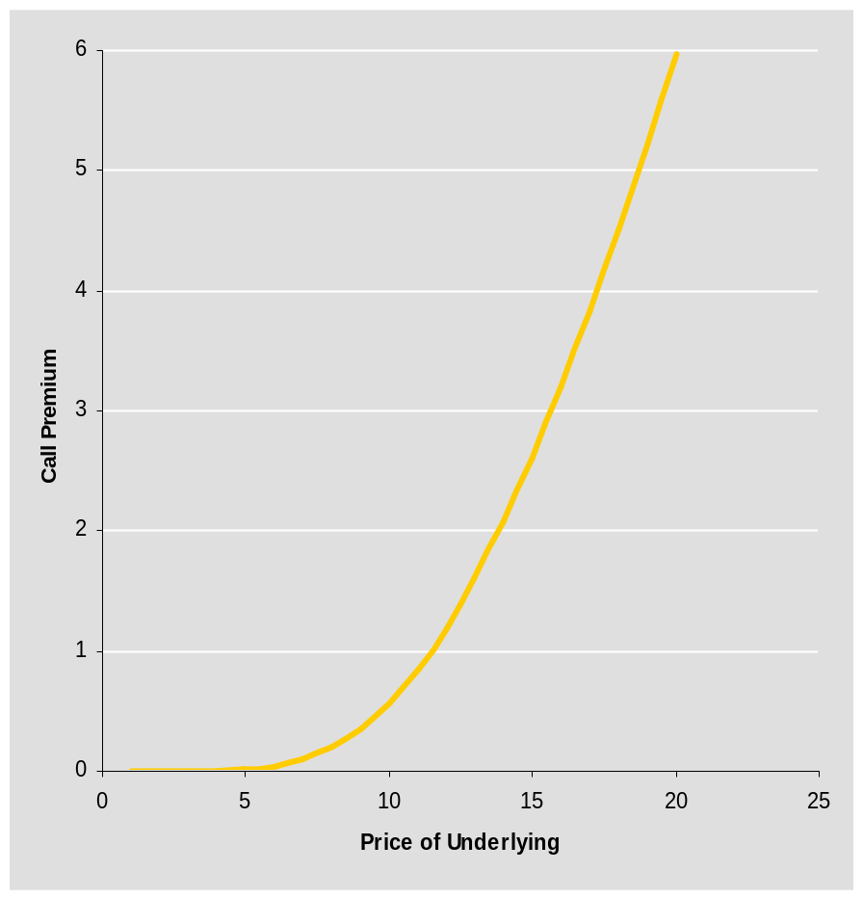
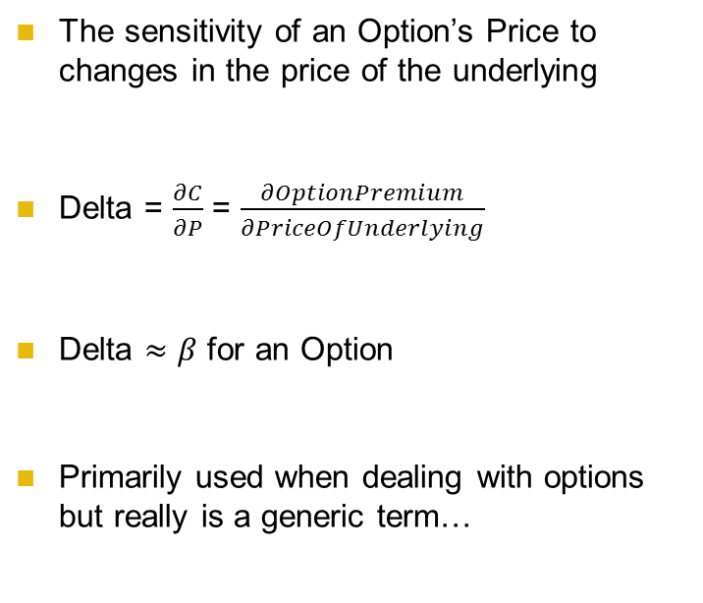
Delta
The sensitivity of an Option’s Price to changes in the price of the underlying
Delta = $\frac{∂C}{∂P}$ = $\frac{∂OptionPremium}{∂PriceOfUnderlying}$
Delta $≈β$ for an Option
Primarily used when dealing with options but really is a generic term…
…Delta and Duration

Slide 20
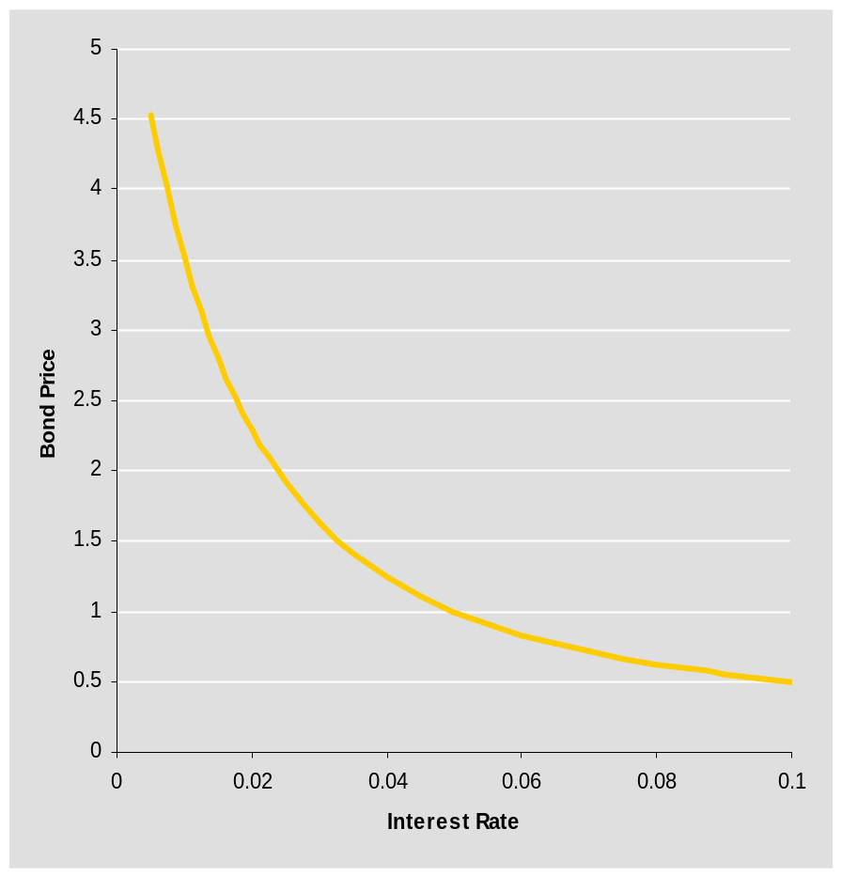
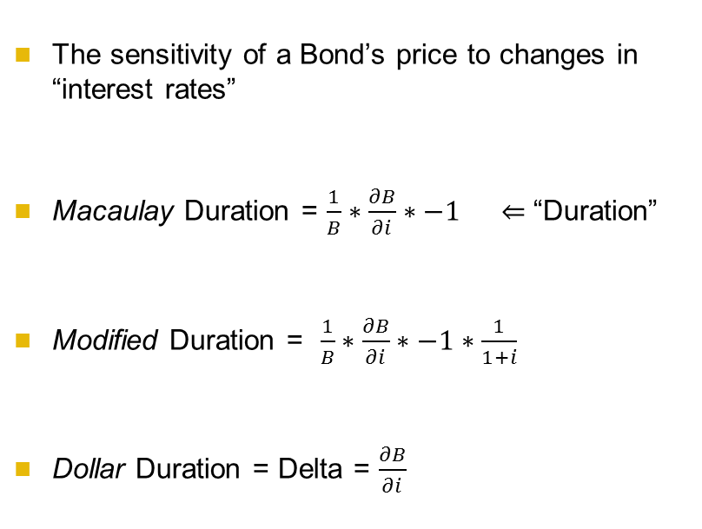
Duration
The sensitivity of a Bond’s price to changes in “interest rates”
Macaulay Duration = $\frac{1}{B}∗\frac{∂B}{∂i}∗−1 ⇐$ “Duration”
Modified Duration = $\frac{1}{B}∗\frac{∂B}{∂i}∗−1∗\frac{1}{1+i}$
Dollar Duration = Delta = $\frac{∂B}{∂i}$
…VaR

Slide 21
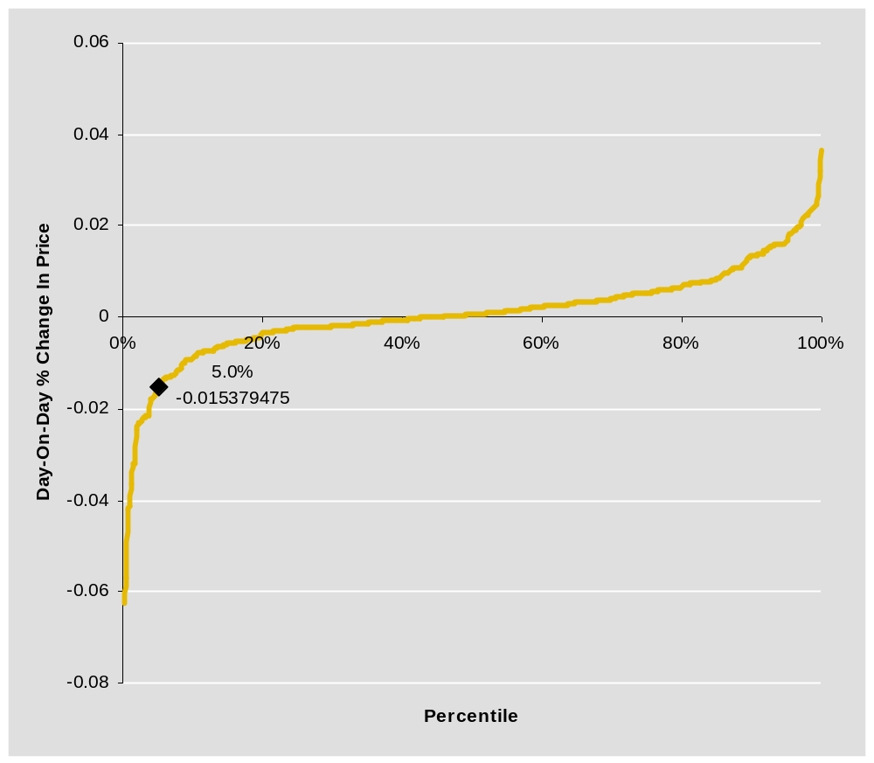
Value-at-Risk
Order the daily % changes in price, from worst loss to best gain
Examine the x percentile, eg. 5%
The highest (ie. least –ve) number within this percentile is our x% daily VaR coefficient
Fund NAV * VaR Coefficient = Value-at-Risk
…Conclusions

Slide 22
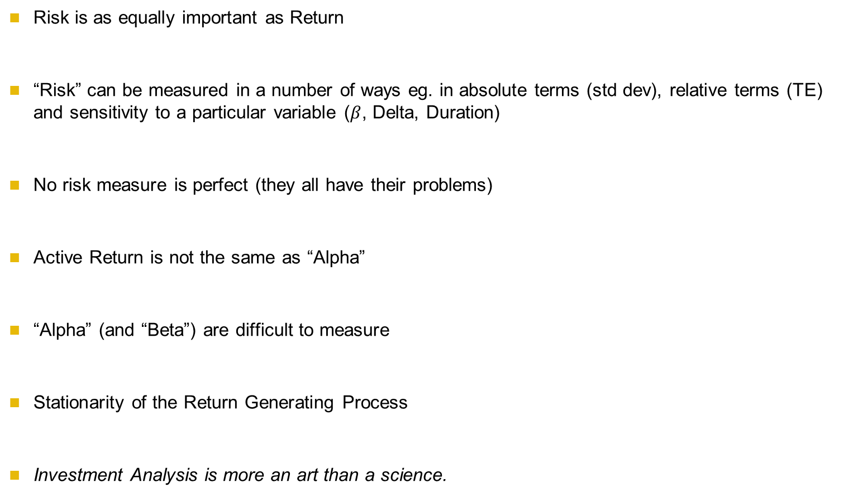
Conclusions
Risk is as equally important as Return
“Risk” can be measured in a number of ways eg. in absolute terms (std dev), relative terms (TE) and sensitivity to a particular variable ($β$, Delta, Duration)
No risk measure is perfect (they all have their problems)
Active Return is not the same as “Alpha”
“Alpha” (and “Beta”) are difficult to measure
Stationarity of the Return Generating Process
Investment Analysis is more an art than a science.

